Slide 1

CASE METHOD WORKSHOP
September 24, 2020
WRITING CASES
THE BASE OF CASE METHODOLOGY
ROCIO REINA

Slide 2
The beginning of everything… the case
Why writing cases?
What is a “good”case?
Cases are more than just a case…
Well… we are decided to write a case, so now… How?

Slide 3

Writing a case
Following an outline or taking the opportunity
Pedagogical objectives
The PROBLEM
Collecting data and facts
Giving the case its own soul
Each company a different writing plan

Slide 4

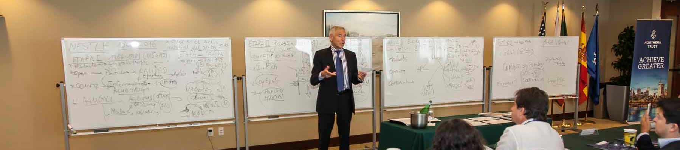
Engaging the company
Show them the benefits
  Reflections during the process
  Ideas
  Learning by participating in the session
  Image
Update the case
Give them other cases as example
Making them part of the institution

Slide 5
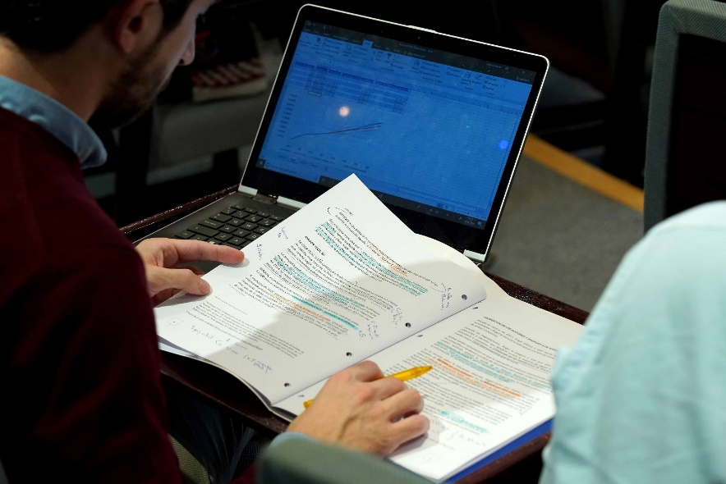
Taking into account
Target audience and layers of the case
Length (Exhibit and Appendix)
Date of Expiry
It’s not a paper. It’s not an article. It’s not an interview
                It’s not for you use only
                Teaching note
                Guest speakers
                Series of cases
                Enriching the session

Slide 6

So… let’s writing cases
​
IT’S NOT JUST WRITING CASES….
IT’S BEING CLOSE TO BUSINESS WORLD
AND
HELP THEM LEARN WITH REAL EXAMPLES!!!
WRITING CASES
THE BASE OF CASE METHODOLOGY
ROCIO REINA
THANKS!!

